Slide 1
Mongo DB Benchmarking with YCSB by ritik hariani srn:pes1201801558

Slide 2
What is YCSB? What IS MONGO DB?
The Yahoo! Cloud Serving Benchmark (YCSB) is an open-source specification and program suite for evaluating retrieval and maintenance capabilities of computer programs. It is often used to compare relative performance of NoSQL database management systems.
MongoDB is a cross-platform document-oriented database program. Classified as a NoSQL database program, MongoDB uses JSON-like documents with schema.

Slide 3
Why we need YCSB?
A standard benchmarking platform to measure the functioning and processing speeds of various NoSQL databases against standardised workloads.
It consist of workload generating client and standard workload packages.

Slide 4
BENCHMARK TIERS
TIER 1 – PERFORMANCE
There is an inherent trade-oﬀ between latency and throughput: on a given hardware setup, as the amount of load increases, the latency of individual requests increases as well since there is more contention for disk, CPU, network and so on
Threads increase the workload into the system and hence, throughput also increases. But the throughput saturates at a specific number of threads and will stay constant for further increase in the number of threads. But too much increase in the number of threads causes overload and the throughput starts to decrease
TIER 2 – SCALING
A key aspect of cloud systems is their ability to scale elastically, so that they can handle more load as applications add features and grow in popularity. The Scaling tier of the database examines the impact on performance as more machines are added to the system.
Factors : Scale-up and Elastic speed up

Slide 5
Workloads
Workload A: Update heavy workload: 50/50% Mix of Reads/Writes
Workload B: Read mostly workload: 95/5% Mix of Reads/Writes
Workload C: Read-only: 100% reads
Workload D: Read the latest workload: More traffic on recent inserts
Workload E: Short ranges: Short range based queries
Workload F: Read-modify-write: Read, modify and update existing records

Slide 6
ANALYSIS OF WORKLOADS
The analysis of the performance of the Database on these workloads will provide us with a clear idea on how effective the Database is with respective to other NoSQL databases and Traditional Databases
We shall analyse the Average Latency and the Throughput achieved for MongoDB against various workloads (A-F) loaded with record from 100k to 500k.
The number of threads used to run these are 16.
Threads are just used to increase/speed up the number of insertions per sec.

Slide 7
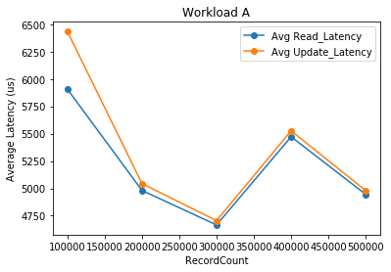
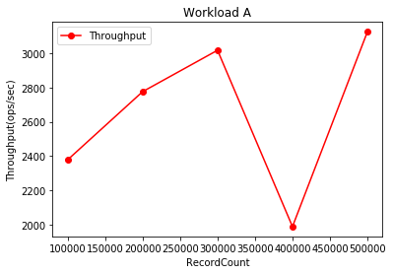
WORKLOAD A

Slide 8
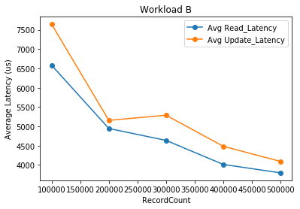
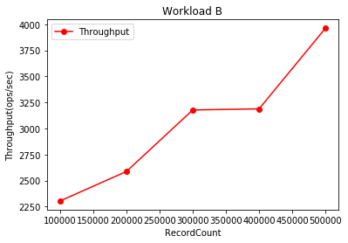
WORKLOAD B

Slide 9
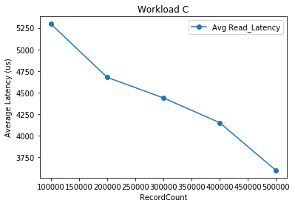
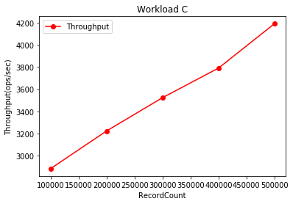
Workload c

Slide 10
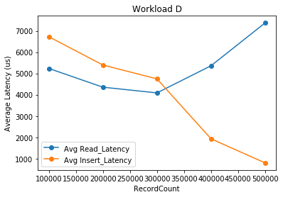
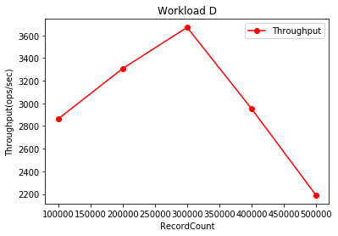
WORKLOAD D

Slide 11
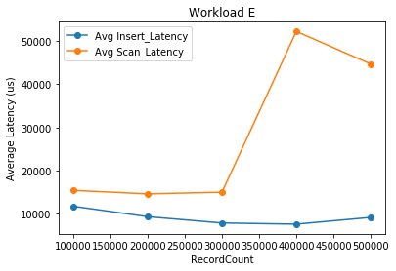
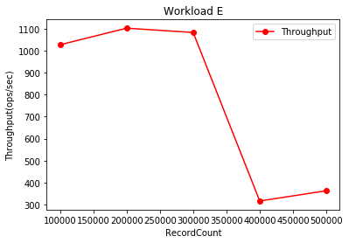
Workload e

Slide 12
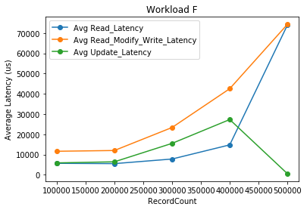
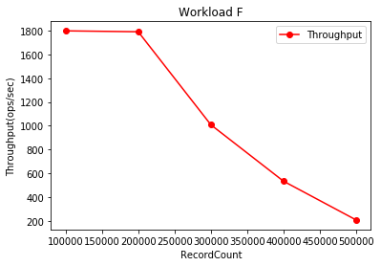
WORKLOAD F

Slide 13
CONCLUSION
YCSB provides a standard to compare different databases on various factors such as total time taken, total ops, average throughput, min/max/average/(95/99)percentile latencies, etc
Hence YCSB is a very effective benchmark framework that must be used by every developer when one decides to choose which DB to be used.

Slide 14
THANK YOU

